Slide 1

Using the Internet to
Simplify & Organize
your life
Copyright Alta 2025

Slide 2
Tools
File storage (backups, versions)
eMail
contacts
photos, albums, sharing
text, voice, & video calls
calendar

Slide 3
more Tools
navigation
virtual travel
books
entertainment
tickets & payments
photo editing

Slide 4
still more Tools
video editing
desktop publishing
websites (personal, business, club)
income taxes
CRA (download all your tax info!!!)
convert files

Slide 5
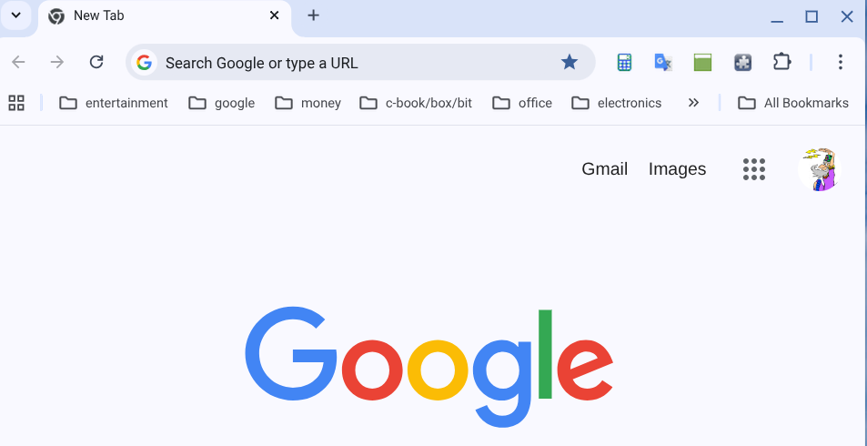
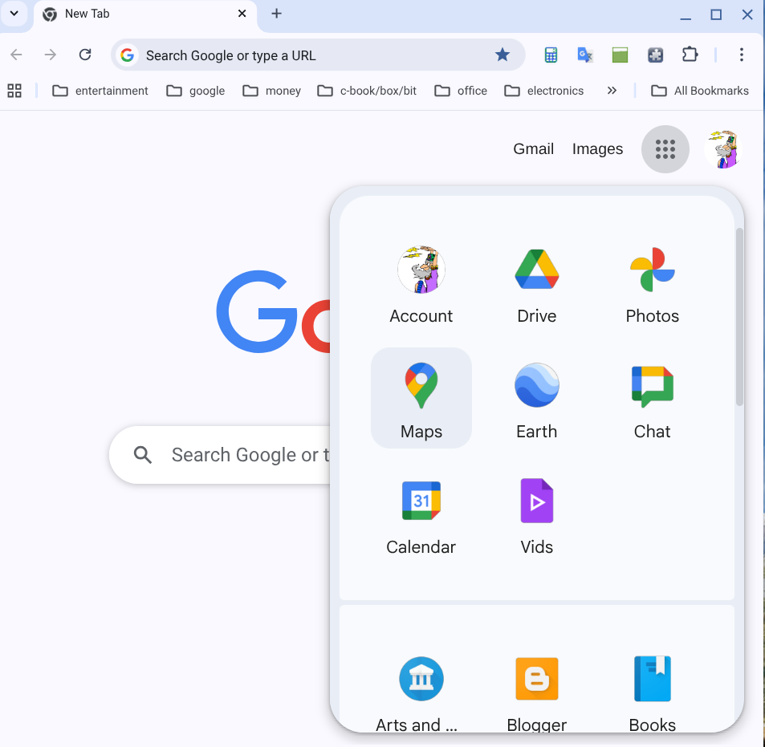
Google “9-dots” menu

Slide 6

File Storage
“Cloud” (God’s hard drive)
google drive, apple cloud, microsoft onedrive, amazon, . . .
15 GB free w/each gmail acct
upgrade to 100GB @ $2.79/mth
auto backup & version control

Slide 7

eMail
DON’T get from internet provider!
gmail, hotmail (outlook.com), yahoo
can merge multiple emails!
can schedule an email
C.C. & B.C.C.
almost instantaneous anywhere

Slide 8

Contacts
google Contacts
used for emails, & for messaging
name, email address, phone #,
physical address, notes, . . .
desktop/laptop/tablet/smartphone
auto-backup & auto-restore

Slide 9

Photos
google Photos
counts toward 15 GB storage
can group in albums, groups similar faces, share with others
can do limited editing
pixlr.com/x (3 @ day free)

Slide 10

Text, Voice, Video calls
google Chat
anywhere
chat messaging, voice calls,
video calls
free!!

Slide 11
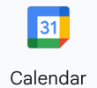
Calendar
google Calendar
events & task lists
desktop/laptop/tablet/smartphone
auto-save
auto-update across devices
free!

Slide 12

Navigation
google Maps
parking mark
voice directions
traffic & speed trap alerts
very current info
free!

Slide 13

Virtual Travel
google Earth
anywhere
satellite imagery
street views
free!

Slide 14

Books
google Books
old & new
huge selection
great for travel or doctor office
free, & a few $

Slide 15
Entertainment
Amazon Prime Video/Music/Books,
Netflix, Kanopy, YouTube,
TED talks, PBS, KnowledgeNet,
Nat’l Geographic, Discovery, . . .
CBC, CTV, Global, City
ABC, NBC, CBS, FOX, CNN, . . .
free!

Slide 16

Tickets & Payments
google Wallet, Apple Wallet, . . .
pay for, & hold tickets
free!

Slide 17
Photo Editing
Pixlr Express pixlr.com/x
free for 3 photos @ day
full-featured photo editor
or, advanced photo editor
Pixlr Editor4 pixlr.com/e

Slide 18
Video Editing
streamlabs.com/video-editor
15 GB storage
max 5 GB upload
max 30 minute video
1080P resolution (1920x1080)
free

Slide 19
Desktop Publishing
Marq DTP-Marq
3 page max
25 MB max
Greeting cards, Newsletters,
Posters

Slide 20
Websites
wix.com
Mobile Homes for the Homeless
Mixed Singles Over Sixty
free

Slide 21
Income Tax
wealthsimple.com/en-ca/tax
don’t enter your data!
download it from CRA
free to enter data, $ to file

Slide 22
Canada Revenue Agency
CRA
automatically input your data to your Income Tax program
file your taxes
get your notice of Assessment

Slide 23
Convert Files
free file conversion
almost any formats
up to 1 GB
free!

Slide 24
Virtual Computer
copy.sh/v86
DOS, Windows, Android, . . .

Slide 25

If you want help
call Alta
778-378-9977

