Slide 1


Uptown Notaries
How we can help you

Slide 2
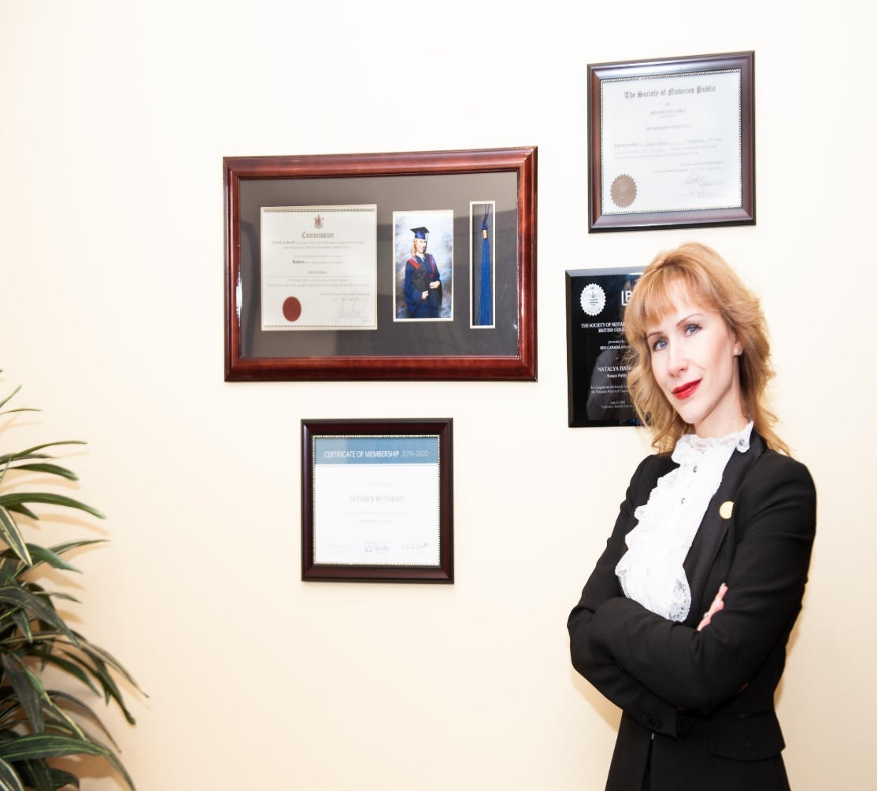
About Natalya Hanna
Law degree overseas
Litigation experience overseas
Master’s program at SFU
2 years of intensive education and practical training
Owner of Uptown Notaries since 2018
Highest degree of honesty and integrity
Dedication to serving the public
Featured by SFU as one of the successful graduates
Award from BDO for the practical training during studies
Active Networker
Mom of three children, reside in Coquitlam

Slide 3
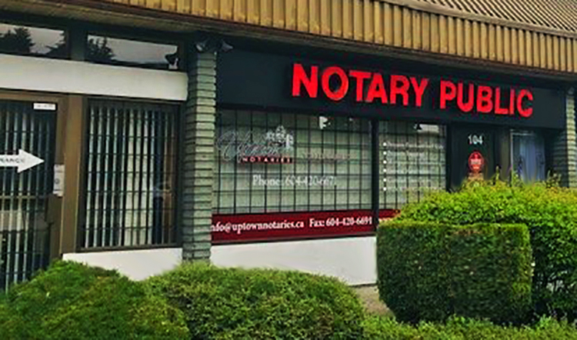
Our Services
Purchase or sale of real estate
Mortgages
Refinance
Business sales
Wills, powers of Attorneys and Rep Agreements

Slide 4
Estate planning services
Wills
Powers of Attorney
Representation Agreements / or Advance Directives

Slide 5

Why do you need a Will?
Five reasons YOU need a Will:
Children under 19
Property ownership
Separation, divorce, or living in a common-law relationship
Peace of mind about your family future
Specific gifts

Slide 6
Dying without a Will: Disposition by Intestacy
Estate is distributed according to legislation
Various formulas depending on who the intestate is survived by
Order of priority for distribution:
1. Spouse (no children)
2. Children (no spouse)
3. Spouse and children
4. Parents
5. Siblings
6. Nephews and nieces

Slide 7
No Will
• Various formulas depending on who the intestate is survived by
• Order of priority for distribution:
1. Spouse (no children)
2. Children (no spouse)
3. Spouse and children
4. Parents
5. Siblings
6. Nephews and nieces
Spouse, but no children | To spouse
No spouse, but children Spouse and children | -To children, if deceases to their children -household furnishings to spouse; first $300,000.00 to spouse (if all child(ren) are of the deceased and surviving spouse); first $150,000.00 to spouse (if child(ren) are of the deceased and another person; residue of estate = ½ to surviving spouse & ½ to deceased’s child(ren)

Slide 8
How to make Will
Mental Capacity
Legal Capacity
Knowledge and approval of contents of the Will
Freedom of undue influence
Signing in front of 2 witnesses

Slide 9

What bypasses the estate
Life Insurance
RRSP
TFSA
Trusts

Slide 10
Wills Notice
Ensures there is record of your Will
No access to the contents of your Will
Good idea to register

Slide 11

Probate Fees
How to avoid

Slide 12
Assessed according to the gross value of the estate
• Only assets that pass through the estate are subject to these fees
• Can avoid these fees by way of inter vivos gifts
• Joint tenancies: ownership passes to the survivor by
operation of law (directly without passing through the estate)
• Insurance, pensions, RRSPs pass directly to designated beneficiaries

Slide 13
Calculated on fair market value of the assets that form the deceased’s estate
Dependent on size of estate, on a graduated basis:
< $25,000: no probate fee;
b) $25,000 – 50,000: $6 per $1000 or part thereof;
Plus
c) > $50,000: $14 per $1000 or part thereof

Slide 14


Is it a good idea to use online platforms?
Online Wills
Digital Will?

Slide 15
Why do you need a Power of Attorney?
You need to take over your parents/spouse/friend finances
It is a precaution in the event that you experience an illness or have an accident that incapacitates you
You might be out of town when financial transaction happens
Most of POAs written for estate planning are enduring and they take effect from the minute that POA is signed

Slide 16
Responsibilities of Attorney
Keep the records
Keep all accounts separate
Be aware what he/she can invest – limitations under Trustee ACT
Record all funds
Reimburse yourself for our of pocket expenses
Can’t get gift to yourself unless the POA permits
POA dies with he doner, can’t use it after death

Slide 17
8. Must not borrow funds
9. Must not incur new debts
10. No loans or gifts to family members
11. Can’t add yourself to joint account

Slide 18
Springing POA
vs
Regular Enduring POA
vs
Specific

Slide 19

Representation Agreement vs Advance Directive
What to choose

Slide 20
Understanding the differences
THE PROBLEM
We are living longer with more chronic illness and dementia.
Advances in medical technology are able to prolong life and dying process.
Poor communication about death and dying among families.

Slide 21
Solution
THE SOLUTION
Understand: about medical care and procedures.
Discuss and Decide in advance: with your family and friends, what medical treatment you want.
Document: write down what you want in an advance directive .

Slide 22
Who and what?
HEALTH CARE DECISIONS: WHO? AND WHAT?
WHO makes health care decisions for me?
Now, and when I am no longer able?
On WHAT does my decision maker base
the decisions made on my behalf?

Slide 23
The Law
BC LEGISLATION: WHO
Patients’ Property Act
Committee of Person
Representation Agreement Act
Representative
Health Care (Consent) and Care Facility (Admission) Act
capable adult
Temporary Substitute Decision Maker
health care provider

Slide 24
Capable Adult
BC law states that every capable adult has the right to give, withhold, or revoke consent to health care.

Slide 25
Committee
COMMITTEE OF PERSON
court appointed
family member, friend, or Public Guardian and Trustee
guardian or Committee of an adult deemed to be incapable of making health
care and personal care decisions

Slide 26
REPRESENTATIVE
capable adult can appoint someone to make health and personal care decisions in the future if he/she becomes incapable
does not need to be family member
Representation Agreement is a legal document, prepared by a lawyer, that appoints a Representative

Slide 27
Why do you need Representation Agreement?
Allow adults to appoint representatives to make their health and personal care decisions if they are not able to.
A Sec 9 RA also allows adults to appoint others to care for their minor children if they become incapable

Slide 28
TEMPORARY SUBSTITUTE DECISION MAKER (TSDM)
a health provider appoints a Temporary Substitute Decision Maker (TSDM) to make health care decision on behalf of an incapable adult.

Slide 29
TEMPORARY SUBSTITUTE DECISION MAKER (TSDM)
Chosen from the following in order:
spouse
adult child
parent
brother or sister
another relative by birth or adoption
another person appointed by OPGT

Slide 30
HEALTH CARE PROVIDER
In emergency situations, a health care provider:
must not provide treatment if he/she has reason to believe that adult did not want treatment
- can provide treatment even if the TSDM or Representative refuses, if health care provider believes TSDM or Representative has not complied with his/her duties

Slide 31
WHO MAKES YOUR HEALTH CARE DECISIONS?
1^{st CHOICE ------ YOU}
2^{ND CHOICE -----COMMITTEE}
3^{RD CHOICE _____Representative}
4^{th CHOICE_______TCDM}
Emergency ----Health Care provider

Slide 32
WHAT? SUBSTITUTE DECISION BASED ON:
capable adult’s expressed wishes
2. adult’s values and beliefs
3. “best interests” of adult

Slide 33
WHAT? EXPRESSING YOUR WISHES
- Representation Agreement says what as well as who
-advance directive or living will
- any other verbal or written expression of wishes-

Slide 34
WHAT = ADVANCE DIRECTIVE
YOUR EXPRESSED WISHES FOR FUTURE HEALTH AND PERSONAL CARE
- YOUR INSTRUCTION TO YOUR LEGALLY-APPOINTED DECISION MAKERS

Slide 35
WHO USES ADVANCE DIRECTIVES?
Committee of Person uses advance directive to make decisions
Representative uses advance directive to make decisions
TSDM uses advance directive to make decisions
Health care provider in emergency situation can use an advance directive

Slide 36
Situation | Who decides
Advance Directive covers the treatment | Follow the Advance Directive
No directive or unclear | Representative decides
RA specifically allows rep to override AD | Representative may decide

Slide 37
Key principle
The law prioritizes the capable adult’s own prior instructions.
So the Representative’s duty is to:
follow the Advance Directive, or
follow the adult’s known wishes, or
act in the adult’s best interests if wishes are unknown.

Slide 38
Nidus Personal Planning Resource Centre and Registry
The Nidus Registry is a secure online registry in Canada (primarily used in British Columbia) where people can register information about their personal planning documents.
It is widely used for documents related to incapacity planning.
What the Nidus Registry does
The registry does NOT store the actual legal documents.
Instead, it stores information about them, such as:
that the document exists, what type of document it is, the date it was signed, who the representative or attorney is and where the original document is kept. This helps health care providers or others find the correct decision-maker quickly in an emergency.

Slide 39

Current promotions for the participants of today’s presenation

Slide 40


604-420-6671 or email Natalya@uptownnotaries.ca
www.Uptownnotaries.ca

